Slide 1
Pneumonia detection on Chest X-Rays using Deep Learning

Slide 2
Approach
Dataset used :- https://www.kaggle.com/paultimothymooney/chest-xray-pneumonia
It contains 5863 images of 2 categories (Normal:- 1341, pneumonia:- 3875).
Libraries used :- Keras with Tensorflow as backend, python, pandas
Accuracy achieved :- 84.69%
Research Paper Referenced :- https://arxiv.org/pdf/1711.05225.pdf (ChexNet)
Note:- as the dataset is small to train a Neural Network , we increased the dataset by flipping, random scaling, and rotating the available images.
ChexNet
An algorithm developed that can detect pneumonia from chest X-rays at a level exceeding practicing radiologists.
This model is trained on 112,120 frontal-view chest X-rays images of 14 diseases.(Atelectasis, Cardiomegaly, Consolidation, Edema, Effusion, Emphysema, Fibrosis, Hernia, Infiltration, Mass, Nodule, Pleural Thickening, Pneumonia, and Pneumothorax. ).

Slide 3
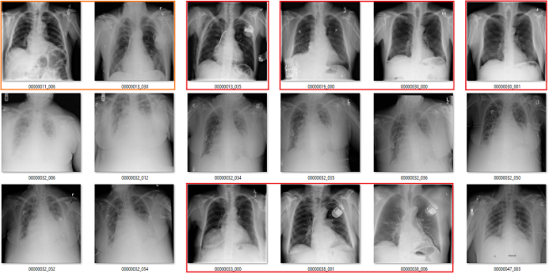


Training Neural Network
Dataset
Augment Dataset
Clean Dataset
Train Model

Slide 4

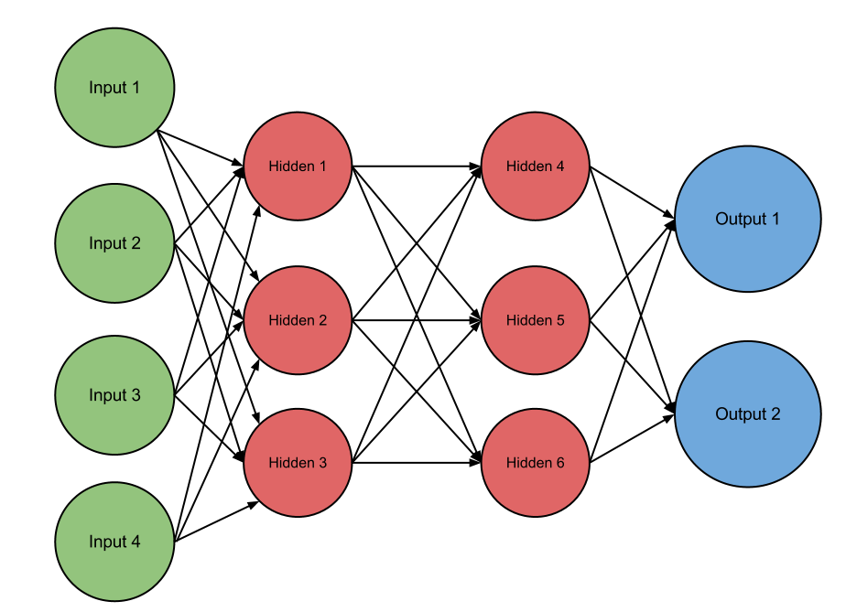



Using Trained Model For Prediction
Image Preprocessing
Rotate Image
Correct orientation of image
Scale
Resize image to (224,224)
Prediction
Input Image
Color Channel
Add color channel if not available
Trained Model

Slide 5

ScreenShots

Slide 6
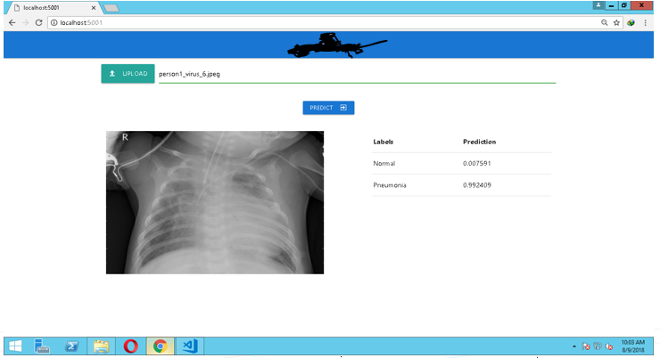
ScreenShots

